Slide 1
Mehran S. Fallah April 2020
Discrete Mathematics
Session IV
Extensions of the Principle of
Inclusion and Exclusion

Slide 2
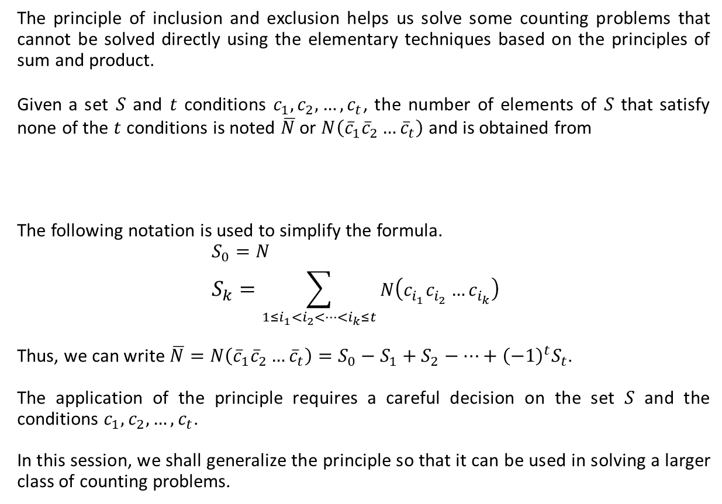
Recapitulation
The principle of inclusion and exclusion helps us solve some counting problems that cannot be solved directly using the elementary techniques based on the principles of sum and product.
Given a set $S$ and $t$ conditions $c_{1}, c_{2},…,c_{t}$, the number of elements of $S$ that satisfy none of the $t$ conditions is noted $\overline{N}$ or $N\left({\overline{c}}_{1}{\overline{c}}_{2}…{\overline{c}}_{t}\right)$ and is obtained from
The following notation is used to simplify the formula.
$S_{0}=N$
$$S_{k}=\sum_{1≤i_{1}<i_{2}<…<i_{k}≤t}{N\left(c_{i_{1}}c_{i_{2}}…c_{i_{k}}\right)}$$
Thus, we can write $\overline{N}=N\left({\overline{c}}_{1}{\overline{c}}_{2}…{\overline{c}}_{t}\right)=S_{0}−S_{1}+S_{2}−…+{\left(−1\right)}^{t}S_{t}$.
The application of the principle requires a careful decision on the set $S$ and the conditions $c_{1}, c_{2},…,c_{t}$.
In this session, we shall generalize the principle so that it can be used in solving a larger class of counting problems.
$$N−\sum_{1≤i≤t}{N\left(c_{i}\right)}+\sum_{1≤i<j≤t}{N\left(c_{i}c_{j}\right)}−\sum_{1≤i<j<k≤t}{N\left(c_{i}c_{j}c_{k}\right)+⋯+{\left(−1\right)}^{t}N\left(c_{1}c_{2}…c_{t}\right).}$$

Slide 3























A Generalization
Let $S$ be a finite set and $c_{1},c_{2}, …, c_{t}$ be $t$ conditions; each element of $S$ satisfies none or some of the elements of $S$.
Let $E_{m}$ denote the number of elements of $S$ that satisfy exactly $m$ of the $t$ conditions.
In the following figure, dark red regions contain the elements of $S$ that satisfy exactly one of the three conditions $c_{1}, c_{2},$ and $c_{3}$. They are $2, 4, 14, 21, 99, 5$, and $25$ ($E_{1}=7$.)
What about $E_{2}$? It is the number of elements in purple regions, that is, $E_{2}=5$.
$$S$$
$$c_{1}$$
$$c_{2}$$
$$2$$
$$12$$
$$21$$
$$4$$
$$18$$
$$91$$
$$96$$
$$99$$
$$14$$
$$240$$
$$1$$
$$100$$
$$135$$
$$77$$
$$5$$
$$25$$
$$19$$
$$37$$
$$c_{3}$$
4

Slide 4









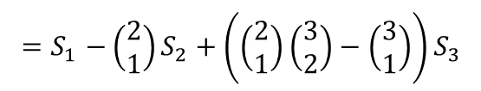


The Case $t=3$
$E_{m}$: The number of elements of $S$ that satisfy exactly $m$ of the $t$ conditions
$$E_{0}=\overline{N}=S_{0}−S_{1}+S_{2}−S_{3}=S_{0}−\left(\begin{matrix}1 \\ 1\end{matrix}\right)S_{1}+\left(\begin{matrix}2 \\ 2\end{matrix}\right)S_{2}−\left(\begin{matrix}3 \\ 3\end{matrix}\right)S_{3}$$
$$E_{1}=N\left(c_{1}\right)+N\left(c_{2}\right)+N\left(c_{3}\right)−2N\left(c_{1}c_{2}\right)−2N\left(c_{1}c_{3}\right)−2N\left(c_{2}c_{3}\right)+3N(c_{1}c_{2}c_{3})$$
$${=S}_{1}−\left(\begin{matrix}2 \\ 1\end{matrix}\right)S_{2}+\left(\left(\begin{matrix}2 \\ 1\end{matrix}\right)\left(\begin{matrix}3 \\ 2\end{matrix}\right)−\left(\begin{matrix}3 \\ 1\end{matrix}\right)\right)S_{3}$$
$${=S}_{1}−\left(\begin{matrix}2 \\ 1\end{matrix}\right)S_{2}+\left(\begin{matrix}3 \\ 2\end{matrix}\right)S_{3}$$
$${=S}_{1}−2S_{2}+3S_{3}$$
$$E_{2}=N\left(c_{1}c_{2}\right)+N\left(c_{1}c_{3}\right)+N\left(c_{2}c_{3}\right)−3N(c_{1}c_{2}c_{3})$$
$${=S}_{2}− 3S_{3}$$
$${=S}_{2}− \left(\begin{matrix}3 \\ 2\end{matrix}\right)S_{3}$$
$$S$$
$$c_{1}$$
$$c_{2}$$
$$E_{3}=N\left(c_{1}c_{2}c_{3}\right)=S_{3}$$
$$c_{3}$$

Slide 5










The Case $t=4$
$$S$$
$$c_{2}$$
$E_{0}:$ R0
$E_{1}:$ R1+R2+R3+R4
$E_{2}:$ R5+R6+R7+R8+R9+R10
$E_{3}:$ R11+R12+R13+R14
$E_{4}:$ R15
$$c_{1}$$
R2
R5
R1
R12
R7
R9
R15
R13
R11
R14
R4
R6
R8
R10
$$c_{4}$$
R0
R3
$$c_{3}$$
$$E_{0}=S_{0}−S_{1}+S_{2}−S_{3}+S_{4}=S_{0}−\left(\begin{matrix}1 \\ 1\end{matrix}\right)S_{1}+\left(\begin{matrix}2 \\ 2\end{matrix}\right)S_{2}−\left(\begin{matrix}3 \\ 3\end{matrix}\right)S_{3}+\left(\begin{matrix}4 \\ 4\end{matrix}\right)S_{4}$$
$$E_{1}=S_{1}−2S_{2}+3S_{3}−4S_{4}=S_{1}−\left(\begin{matrix}2 \\ 1\end{matrix}\right)S_{2}+\left(\begin{matrix}3 \\ 2\end{matrix}\right)S_{3}−\left(\begin{matrix}4 \\ 3\end{matrix}\right)S_{4}$$
$$E_{2}=S_{2}−3S_{3}+6S_{4}=S_{2}−\left(\begin{matrix}3 \\ 1\end{matrix}\right)S_{3}+\left(\begin{matrix}4 \\ 2\end{matrix}\right)S_{4}$$
$$E_{3}=S_{3}−4S_{4}=S_{3}−\left(\begin{matrix}4 \\ 1\end{matrix}\right)S_{4}$$
$$E_{4}=S_{4}$$

Slide 6
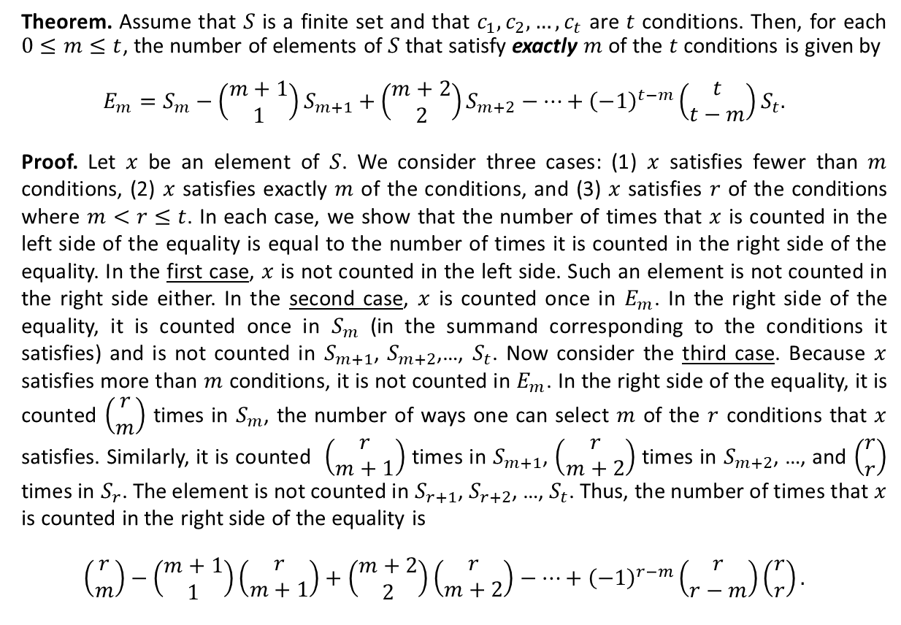
A Generalized Principle
Theorem. Assume that $S$ is a finite set and that $c_{1},c_{2},…, c_{t}$ are $t$ conditions. Then, for each $0≤m≤t$, the number of elements of $S$ that satisfy exactly $m$ of the $t$ conditions is given by
$$E_{m}=S_{m}−\left(\begin{matrix}m+1 \\ 1\end{matrix}\right)S_{m+1}+\left(\begin{matrix}m+2 \\ 2\end{matrix}\right)S_{m+2}−…+{\left(−1\right)}^{t−m}\left(\begin{matrix}t \\ t−m\end{matrix}\right)S_{t}.$$
Proof. Let $x$ be an element of $S$. We consider three cases: (1) $x$ satisfies fewer than $m$ conditions, (2) $x$ satisfies exactly $m$ of the conditions, and (3) $x$ satisfies $r$ of the conditions where $m<r≤t$. In each case, we show that the number of times that $x$ is counted in the left side of the equality is equal to the number of times it is counted in the right side of the equality. In the first case, $x$ is not counted in the left side. Such an element is not counted in the right side either. In the second case, $x$ is counted once in $E_{m}$. In the right side of the equality, it is counted once in $S_{m}$ (in the summand corresponding to the conditions it satisfies) and is not counted in $S_{m+1}$, $S_{m+2}$,…, $S_{t}$. Now consider the third case. Because $x$ satisfies more than $m$ conditions, it is not counted in $E_{m}$. In the right side of the equality, it is counted $\left(\begin{matrix}r \\ m\end{matrix}\right)$ times in $S_{m}$, the number of ways one can select $m$ of the $r$ conditions that $x$ satisfies. Similarly, it is counted $\left(\begin{matrix}r \\ m+1\end{matrix}\right)$ times in $S_{m+1}$, $\left(\begin{matrix}r \\ m+2\end{matrix}\right)$ times in $S_{m+2}$, …, and $\left(\begin{matrix}r \\ r\end{matrix}\right)$ times in $S_{r}$. The element is not counted in $S_{r+1}$, $S_{r+2}$, …, $S_{t}$. Thus, the number of times that $x$ is counted in the right side of the equality is
$$\left(\begin{matrix}r \\ m\end{matrix}\right)−\left(\begin{matrix}m+1 \\ 1\end{matrix}\right)\left(\begin{matrix}r \\ m+1\end{matrix}\right)+\left(\begin{matrix}m+2 \\ 2\end{matrix}\right)\left(\begin{matrix}r \\ m+2\end{matrix}\right)−…+{\left(−1\right)}^{r−m}\left(\begin{matrix}r \\ r−m\end{matrix}\right)\left(\begin{matrix}r \\ r\end{matrix}\right).$$

Slide 7

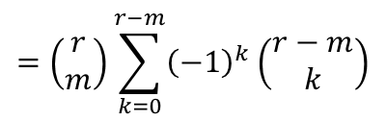

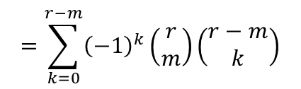
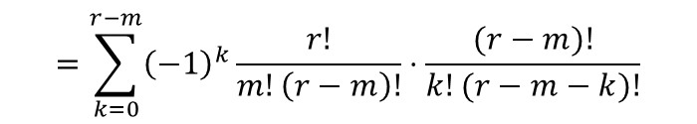
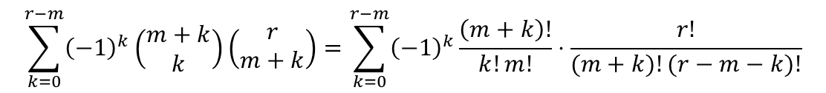
Proof (Ctd.)
Thus, the number of times that $x$ is counted in the right side of the equality is
$$\left(\begin{matrix}r \\ m\end{matrix}\right)−\left(\begin{matrix}m+1 \\ 1\end{matrix}\right)\left(\begin{matrix}r \\ m+1\end{matrix}\right)+\left(\begin{matrix}m+2 \\ 2\end{matrix}\right)\left(\begin{matrix}r \\ m+2\end{matrix}\right)−…+{\left(−1\right)}^{r−m}\left(\begin{matrix}r \\ r−m\end{matrix}\right)\left(\begin{matrix}r \\ r\end{matrix}\right).$$
It can be written as
$$\sum_{k=0}^{r−m}{{\left(−1\right)}^{k}\left(\begin{matrix}m+k \\ k\end{matrix}\right)\left(\begin{matrix}r \\ m+k\end{matrix}\right)}=\sum_{k=0}^{r−m}{{\left(−1\right)}^{k}}\frac{\left(m+k\right)!}{k!m!}⋅\frac{r!}{(m+k)!(r−m−k)!}$$
$$=\sum_{k=0}^{r−m}{{\left(−1\right)}^{k}}\frac{r!}{m!\left(r−m\right)!}⋅\frac{(r−m)!}{k!(r−m−k)!}$$
$$=\sum_{k=0}^{r−m}{{\left(−1\right)}^{k}}\left(\begin{matrix}r \\ m\end{matrix}\right)\left(\begin{matrix}r−m \\ k\end{matrix}\right)$$
$$=\left(\begin{matrix}r \\ m\end{matrix}\right)\sum_{k=0}^{r−m}{{\left(−1\right)}^{k}}\left(\begin{matrix}r−m \\ k\end{matrix}\right)$$
$$=\left(\begin{matrix}r \\ m\end{matrix}\right){\left(1−1\right)}^{r−m}=0$$

Slide 8

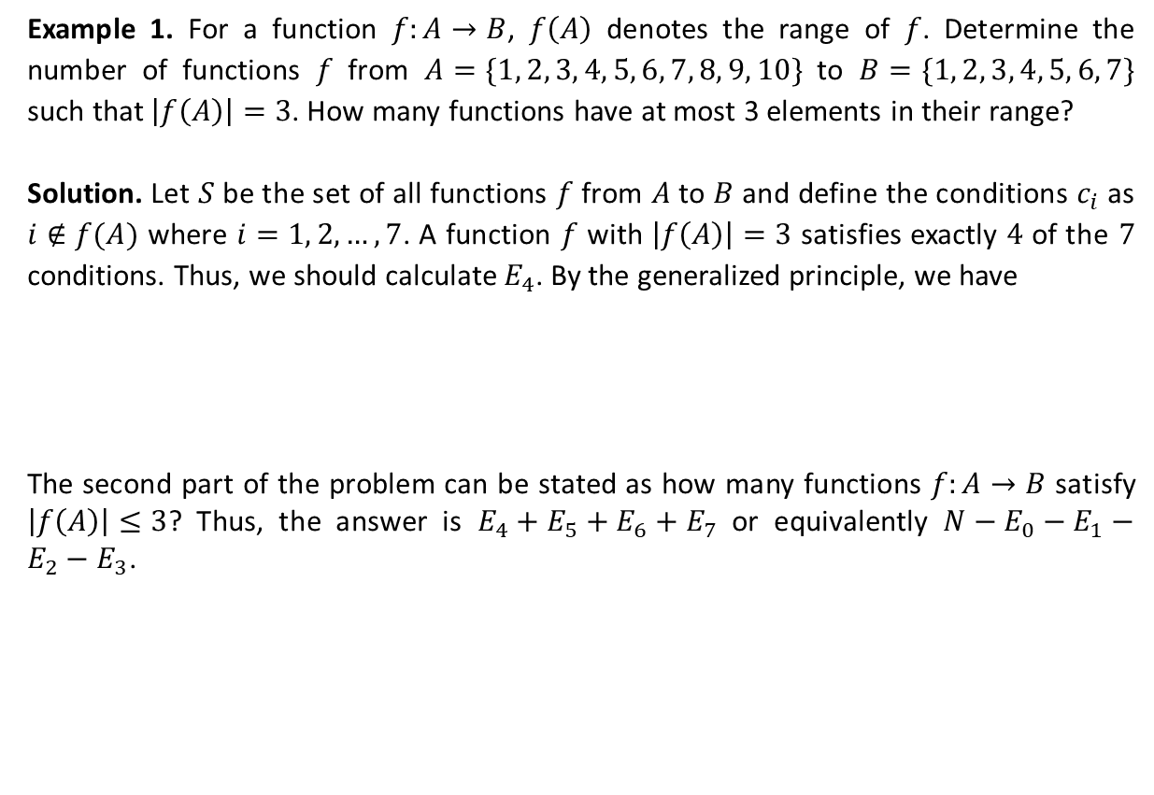





Application of the Generalized Principle
Example 1. For a function $f:A→B$, $f\left(A\right)$ denotes the range of $f$. Determine the number of functions $f$ from $A=\{1, 2, 3, 4, 5, 6, 7, 8, 9, 10\}$ to $B=\{1, 2, 3, 4, 5, 6, 7\}$ such that $\left|f\left(A\right)\right|=3$. How many functions have at most 3 elements in their range?
Solution. Let $S$ be the set of all functions $f$ from $A$ to $B$ and define the conditions $c_{i}$ as $i∉f(A)$ where $i=1, 2, …, 7$. A function $f$ with $\left|f\left(A\right)\right|=3$ satisfies exactly $4$ of the $7$ conditions. Thus, we should calculate $E_{4}$. By the generalized principle, we have
The second part of the problem can be stated as how many functions $f:A→B$ satisfy $\left|f\left(A\right)\right|≤3$? Thus, the answer is $E_{4}+E_{5}+E_{6}+E_{7}$ or equivalently $N−E_{0}−E_{1}−E_{2}−E_{3}$.
$$E_{4}=S_{4}−\left(\begin{matrix}5 \\ 1\end{matrix}\right)S_{5}+\left(\begin{matrix}6 \\ 2\end{matrix}\right)S_{6}−\left(\begin{matrix}7 \\ 3\end{matrix}\right)S_{7}$$
$$=\left(\begin{matrix}7 \\ 4\end{matrix}\right)3^{10}−\left(\begin{matrix}5 \\ 1\end{matrix}\right)\left(\begin{matrix}7 \\ 5\end{matrix}\right)2^{10}+\left(\begin{matrix}6 \\ 2\end{matrix}\right)\left(\begin{matrix}7 \\ 6\end{matrix}\right)1^{10}−\left(\begin{matrix}7 \\ 3\end{matrix}\right)\left(\begin{matrix}7 \\ 7\end{matrix}\right)0^{10}$$
$= 1,959,300$.
$$E_{5}=S_{5}−\left(\begin{matrix}6 \\ 1\end{matrix}\right)S_{6}+\left(\begin{matrix}7 \\ 2\end{matrix}\right)S_{7}=\left(\begin{matrix}7 \\ 5\end{matrix}\right)2^{10}−\left(\begin{matrix}6 \\ 1\end{matrix}\right)\left(\begin{matrix}7 \\ 6\end{matrix}\right)1^{10}+\left(\begin{matrix}7 \\ 2\end{matrix}\right)\left(\begin{matrix}7 \\ 7\end{matrix}\right)0^{10}=21,462$$
$$E_{6}=S_{6}−\left(\begin{matrix}7 \\ 1\end{matrix}\right)S_{7}=\left(\begin{matrix}7 \\ 6\end{matrix}\right)1^{10}+\left(\begin{matrix}7 \\ 1\end{matrix}\right)\left(\begin{matrix}7 \\ 7\end{matrix}\right)0^{10}=7$$
$$E_{7}=0$$
$$E_{4}+E_{5}+E_{6}+E_{7}=1,980,769$$

Slide 9
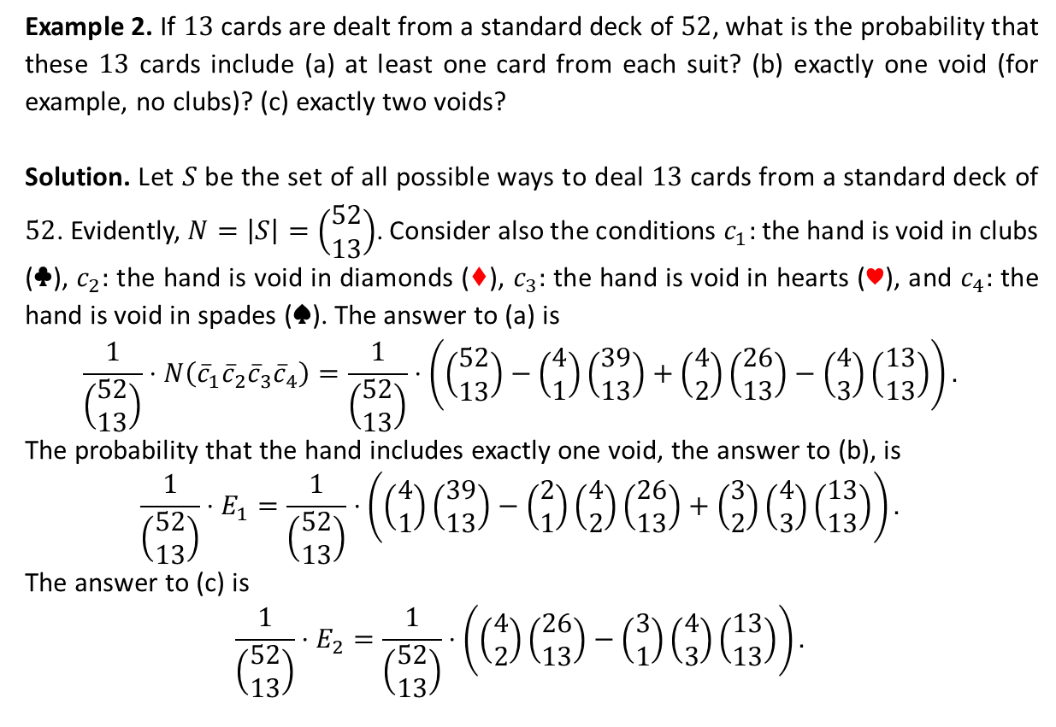
Application of the Generalized Principle (Ctd.)
Example 2. If $13$ cards are dealt from a standard deck of $52$, what is the probability that these $13$ cards include (a) at least one card from each suit? (b) exactly one void (for example, no clubs)? (c) exactly two voids?
Solution. Let $S$ be the set of all possible ways to deal $13$ cards from a standard deck of $52$. Evidently, $N=\left|S\right|=\left(\begin{matrix}52 \\ 13\end{matrix}\right)$. Consider also the conditions $c_{1}:$ the hand is void in clubs (♣), $c_{2}:$ the hand is void in diamonds (♦), $c_{3}:$ the hand is void in hearts (♥), and $c_{4}:$ the hand is void in spades (♠). The answer to (a) is
$$\frac{1}{\left(\begin{matrix}52 \\ 13\end{matrix}\right)}⋅N\left({\overline{c}}_{1}{\overline{c}}_{2}{\overline{c}}_{3}{\overline{c}}_{4}\right)=\frac{1}{\left(\begin{matrix}52 \\ 13\end{matrix}\right)}⋅\left(\left(\begin{matrix}52 \\ 13\end{matrix}\right)−\left(\begin{matrix}4 \\ 1\end{matrix}\right)\left(\begin{matrix}39 \\ 13\end{matrix}\right)+\left(\begin{matrix}4 \\ 2\end{matrix}\right)\left(\begin{matrix}26 \\ 13\end{matrix}\right)−\left(\begin{matrix}4 \\ 3\end{matrix}\right)\left(\begin{matrix}13 \\ 13\end{matrix}\right)\right).$$
The probability that the hand includes exactly one void, the answer to (b), is
$$\frac{1}{\left(\begin{matrix}52 \\ 13\end{matrix}\right)}⋅E_{1}=\frac{1}{\left(\begin{matrix}52 \\ 13\end{matrix}\right)}⋅\left(\left(\begin{matrix}4 \\ 1\end{matrix}\right)\left(\begin{matrix}39 \\ 13\end{matrix}\right)−\left(\begin{matrix}2 \\ 1\end{matrix}\right)\left(\begin{matrix}4 \\ 2\end{matrix}\right)\left(\begin{matrix}26 \\ 13\end{matrix}\right)+\left(\begin{matrix}3 \\ 2\end{matrix}\right)\left(\begin{matrix}4 \\ 3\end{matrix}\right)\left(\begin{matrix}13 \\ 13\end{matrix}\right)\right).$$
The answer to (c) is
$$\frac{1}{\left(\begin{matrix}52 \\ 13\end{matrix}\right)}⋅E_{2}=\frac{1}{\left(\begin{matrix}52 \\ 13\end{matrix}\right)}⋅\left(\left(\begin{matrix}4 \\ 2\end{matrix}\right)\left(\begin{matrix}26 \\ 13\end{matrix}\right)−\left(\begin{matrix}3 \\ 1\end{matrix}\right)\left(\begin{matrix}4 \\ 3\end{matrix}\right)\left(\begin{matrix}13 \\ 13\end{matrix}\right)\right).$$

Slide 10









Another Generalization of the Principle
Let $L_{m}$ denote the number of elements of $S$ that satisfy at least $m$ of the $t$ conditions.
It is immediate that $E_{m}≤L_{m}$. Moreover, $L_{m}≤S_{m}$.
The following equalities hold.
$L_{t}=E_{t}=S_{t}$
$L_{m−1}=E_{m−1}+L_{m}$
Thus,
$$S$$
$$c_{1}$$
$$c_{2}$$
$$L_{t−1}=E_{t−1}+L_{t}$$
$$=S_{t−1}−\left(\begin{matrix}t \\ 1\end{matrix}\right)S_{t}+S_{t}$$
$$c_{3}$$
$$=S_{t−1}−\left(\begin{matrix}t−1 \\ t−2\end{matrix}\right)S_{t}.$$
$$L_{t−2}=E_{t−2}+L_{t−1}=S_{t−2}−\left(\begin{matrix}t−1 \\ 1\end{matrix}\right)S_{t−1}+\left(\begin{matrix}t \\ 2\end{matrix}\right)S_{t}+S_{t−1}−\left(\begin{matrix}t−1 \\ t−2\end{matrix}\right)S_{t}$$
$$=S_{t−2}−\left(\begin{matrix}t−2 \\ t−3\end{matrix}\right)S_{t−1}+\left(\begin{matrix}t−1 \\ t−3\end{matrix}\right)S_{t}$$

Slide 11

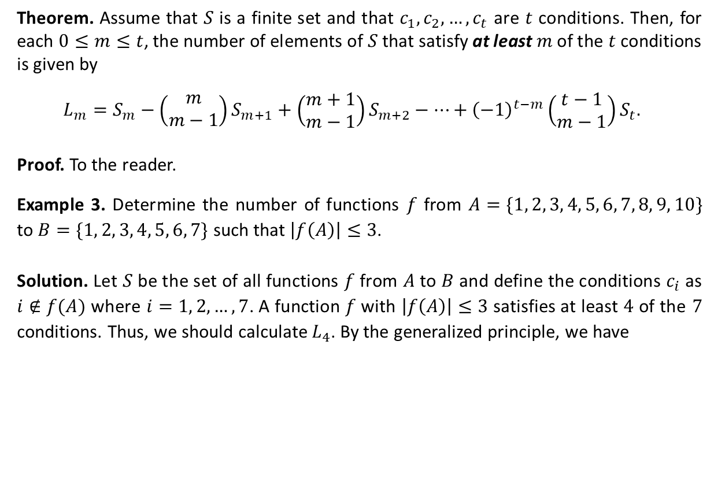


Another Generalization of the Principle (ctd.)
Theorem. Assume that $S$ is a finite set and that $c_{1},c_{2},…, c_{t}$ are $t$ conditions. Then, for each $0≤m≤t$, the number of elements of $S$ that satisfy at least $m$ of the $t$ conditions is given by
$$L_{m}=S_{m}−\left(\begin{matrix}m \\ m−1\end{matrix}\right)S_{m+1}+\left(\begin{matrix}m+1 \\ m−1\end{matrix}\right)S_{m+2}−…+{\left(−1\right)}^{t−m}\left(\begin{matrix}t−1 \\ m−1\end{matrix}\right)S_{t}.$$
Proof. To the reader.
Example 3. Determine the number of functions $f$ from $A=\{1, 2, 3, 4, 5, 6, 7, 8, 9, 10\}$ to $B=\{1, 2, 3, 4, 5, 6, 7\}$ such that $\left|f\left(A\right)\right|≤3$.
Solution. Let $S$ be the set of all functions $f$ from $A$ to $B$ and define the conditions $c_{i}$ as $i∉f(A)$ where $i=1, 2, …, 7$. A function $f$ with $\left|f\left(A\right)\right|≤3$ satisfies at least $4$ of the $7$ conditions. Thus, we should calculate $L_{4}$. By the generalized principle, we have
$$L_{4}=S_{4}−\left(\begin{matrix}4 \\ 3\end{matrix}\right)S_{5}+\left(\begin{matrix}5 \\ 3\end{matrix}\right)S_{6}−\left(\begin{matrix}6 \\ 3\end{matrix}\right)S_{7}$$
$$=\left(\begin{matrix}7 \\ 4\end{matrix}\right)3^{10}−\left(\begin{matrix}4 \\ 3\end{matrix}\right)\left(\begin{matrix}7 \\ 5\end{matrix}\right)2^{10}+\left(\begin{matrix}5 \\ 3\end{matrix}\right)\left(\begin{matrix}7 \\ 6\end{matrix}\right)1^{10}−\left(\begin{matrix}6 \\ 3\end{matrix}\right)⋅0$$
$$=\text{1,980,769}$$

Slide 12

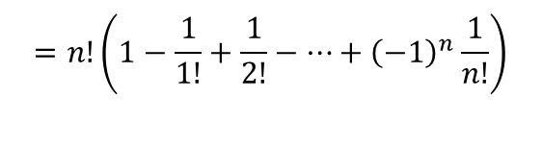
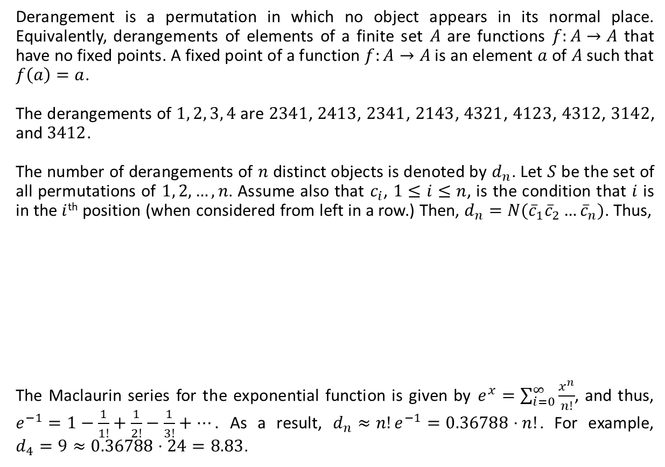

Derangement: Nothing Is in Its Right Place
Derangement is a permutation in which no object appears in its normal place. Equivalently, derangements of elements of a finite set $A$ are functions $f:A→A$ that have no fixed points. A fixed point of a function $f:A→A$ is an element $a$ of $A$ such that $f\left(a\right)=a$.
The derangements of $1, 2, 3, 4$ are $2341$, $2413$, $2341$, $2143$, $4321$, $4123$, $4312$, $3142$, and $3412$.
The number of derangements of $n$ distinct objects is denoted by $d_{n}$. Let $S$ be the set of all permutations of $1, 2, …, n$. Assume also that $c_{i}$, $1≤i≤n$, is the condition that $i$ is in the $i$^{th} position (when considered from left in a row.) Then, $d_{n}=N({\overline{c}}_{1}{\overline{c}}_{2}…{\overline{c}}_{n})$. Thus,
The Maclaurin series for the exponential function is given by $e^{x}=\sum_{i=0}^{∞}{\frac{x^{n}}{n!}}$, and thus, $e^{−1}=1−\frac{1}{1!}+\frac{1}{2!}−\frac{1}{3!}+….$ As a result, $d_{n}≈n!e^{−1}=0.36788⋅n!$. For example, $d_{4}=9≈0.36788⋅24=8.83$.
$$d_{n}=n!−\left(\begin{matrix}n \\ 1\end{matrix}\right)\left(n−1\right)!+\left(\begin{matrix}n \\ 1\end{matrix}\right)\left(n−1\right)!−…+{\left(−1\right)}^{n}\left(n−n\right)!$$
$$=n!−\frac{n!}{1!}+\frac{n!}{2!}−…+{\left(−1\right)}^{n}\frac{n!}{n!}$$
$$=n!\left(1−\frac{1}{1!}+\frac{1}{2!}−…+{\left(−1\right)}^{n}\frac{1}{n!}\right)$$
$$=n!\sum_{i=0}^{n}{\frac{{\left(−1\right)}^{i}}{i!}}$$

Slide 13
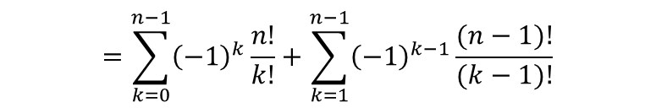
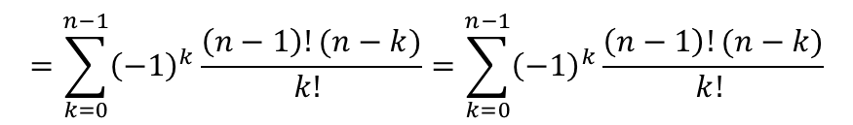

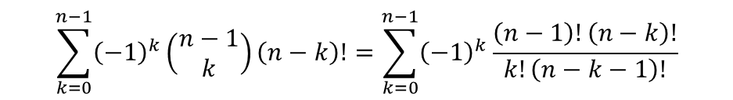
Derangement (Ctd.)
Example 4. a) In how many ways can the integers $1, 2, …, n$ be arranged in a line so that none of the patterns $12, 23, 34, …, \left(n−1\right)n$ occurs? b) Show that the result in part (a) equals $d_{n}+d_{n−1}$.
Solution. Let $S$ be the set of all permutations of $1, 2, …, n$, and $c_{i}$, $1≤i≤n−1$, be the condition that the pattern $i(i+1)$ occurs in the permutation. The answer to part (a) is thus $N({\overline{c}}_{1}{\overline{c}}_{2}…{\overline{c}}_{n−1})$, which is equal to
The answer to part (a) can be written as
$$n!−\left(\begin{matrix}n−1 \\ 1\end{matrix}\right)\left(n−1\right)!+\left(\begin{matrix}n−1 \\ 2\end{matrix}\right)\left(n−2\right)!−…+{\left(−1\right)}^{n−1}\left(\begin{matrix}n−1 \\ n−1\end{matrix}\right)1!.$$
$$\sum_{k=0}^{n−1}{{\left(−1\right)}^{k}\left(\begin{matrix}n−1 \\ k\end{matrix}\right)}\left(n−k\right)!=\sum_{k=0}^{n−1}{{\left(−1\right)}^{k}\frac{\left(n−1\right)!\left(n−k\right)!}{k!\left(n−k−1\right)!}}$$
$$=\sum_{k=0}^{n−1}{{\left(−1\right)}^{k}\frac{\left(n−1\right)!(n−k)}{k! }}=\sum_{k=0}^{n−1}{{\left(−1\right)}^{k}\frac{\left(n−1\right)!(n−k)}{k! }}$$
$$=\sum_{k=0}^{n−1}{{\left(−1\right)}^{k}\frac{n!}{k!}}+\sum_{k=1}^{n−1}{{\left(−1\right)}^{k−1}\frac{(n−1)!}{(k−1)!}}$$
$$=d_{n}−{\left(−1\right)}^{n}+d_{n−1}−{\left(−1\right)}^{n−1}=d_{n}+d_{n−1}.$$

Slide 14
Textbook: Ralph P. Grimaldi, Discrete and Combinatorial Mathematics
Do exercises of Chapter 8 as homework and upload your solutions via Moodle (follow the instructions on the page of the TA of this course.)

